Slide 1
Unit 2
Overcoming obstacles

Slide 2
Proverbs
The greater the obstacle, the more glory in overcoming it.
— Molière
No pain, no palm; no thorns, no throne; no gall, no glory; no cross, no crown.
— William Penn
What do you get from the proverbs?

Slide 3
Brainstorming
What could be obstacles in people’s life?
What are your obstacles?

Slide 4
Discuss the following:
What were the obstacles that you were ever faced with? And how did you overcome them?
What are the problems that you still have now? How are you going to deal with them?

Slide 5
Some Suggestions to Overcome Obstacles
From your own experience, can you offer some suggestions to overcome obstacles?

Slide 6
Listening activity
Watch this video about the failures of eleven famous people, learn what obstacle(s) they each had to overcome, and summarize what they have in common.

Slide 7
obstaclesBefore Reading
Name | Profession | Obstacle(s)
Michael Jordan
Albert Einstein
Oprah Winfrey
Walt Disney
Lionel Messi
Steve Jobs

Slide 8
Before Reading
Name | Profession | Obstacle(s)
Thomas Edison
The Beatles
Eminem
Dr. Seuss
Abraham Lincoln

Slide 9
expressions
the crippled, the disabled, the handicapped

Slide 10
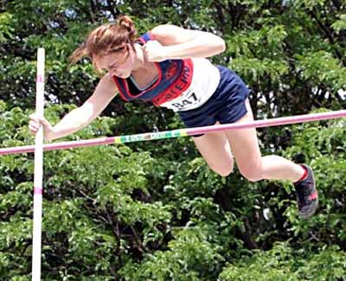
Pole Vault
The pole vault (PV) is an event in track and field where athletes complete to clear the highest possible crossbar (横木) by using a vaulting pole. The basic concept is to convert horizontal energy (the run) into vertical energy (thus clearing a higher bar).

Slide 11
Scanning
There are many words or phrases related to sports or stadium. Find them out.
The text consists of the main story and a flashback. Can you figure out the flashback?
The meaning of “work”.

Slide 12
sports words
referee, professional, amateur, sports events, field events, track events, spectator, world-record holder, enthusiast, bronze medalist, sportsmanship, fan, dark horse
contestant, competitor, player, athlete, sportsman,

Slide 13
Text Analysis
1. What is the meaning of the title “True Height”?
2. The author keeps the secret about Michael's blindness until the last sentence in Text A. Could you explain the way of writing?

Slide 14
Reading for fun:
Replying to an Invitation to a Scientists' Ball
Pierre and Marie Curie were radiating enthusiasm;
Einstein thought it would be relatively easy to attend;
Volta was electrified and Archimedes, buoyant at the thought;
Ampere was worried he wasn’t up to current research;
Ohm resisted the idea at first;
Boyle said he was under too much pressure;
Edison thought it would be an illuminating experience;
Watt reckoned it would be a good way to let off steam;
Wilbur Wright accepted, provided he and Orville could get a flight;
Morse’s reply: “I’ll be there on the dot. Can’t stop now – must dash.”

Slide 15
The ending:
“It was simply because Michael Stone is blind.”
Questions:
1. Can you imagine what difficulties Michael stone has met?
2. What is the effect of this sentence?

Slide 16
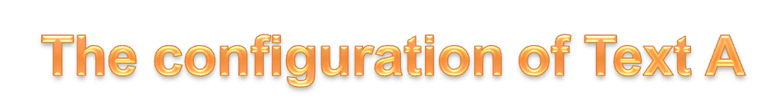
Part One Paras 1-2
Michael faced the most challenging competition in his pole-vaulting career.
Part Two Paras 3-5
Michael' s childhood was marked with dreams and tough training.
Part Three Paras 6-12
Michael topped his personal best, won the championship and set a new world record.
Part Four Para 13
What was most unusual about Michael's victory was that he was blind.

Slide 17
Language Points
detail (Para.3)
Collocation:
go / enter into detail
in (great) detail
He could still remember every detail of the
event though it happened many years ago.

Slide 18
recur (Para.3)
1. come or happen again
2. (of ideas, event, etc.) come back
Pattern：
recur to sb. / sth.
My first meeting with her often recurs to my memory.
occur

Slide 19
coincide (Para.4)
1) (of ideas, opinions, etc.) be in agreement
2) happen at the same time
+ with / in

Slide 20
alternate (Para.5)
every other or second
(of two things) happening by turns
alternating current, alternative
a., v.
Collocation:
alternate between 时而…时而…
alternate in 轮流
alternate with（使）与…交替

Slide 21
vain (Para.6)
1) too pleased with one's own abilities or looks
2) without result, useless, e.g., in vain

Slide 22
Fill in the blanks. vain, empty, hollow, bare
1) The cinema was half ____.
2) We've made a _____ attempt to make him change his mind.
3) Don't sleep on ____ ground.
4) The poor girl went on for another ten miles on a(n) ____ stomach.
5) The walls look solid, but in fact they're _____.

Slide 23
along with (Para.10): together with
all along 始终；一直
come along 进展;跟着来
get along 进展；与…和睦相处
go along 进展；前进；同行

Slide 24
Oxymoron
The silence was deafening. (Para.10)
Contradictory: silence and deafening? Oxymoron: juxtaposing opposites
By juxtaposing words with opposite meanings, an author creates a mood of confusion, insanity, or grief.

Slide 25
Examples:
The pain of divorce is like cold fire.
The living dead, hot ice, sick health, etc.

Slide 26
bring (sb.) back to earth (Para.12)
cause sb. to stop daydreaming; cause sb. to return to reality
Collocation:
come back to earth
come down to earth
on earth

Slide 27
Useful expressions
1. 俯瞰 7. 仰面躺着
2. 深呼吸 8. 一份非常周密的训练计划
3. 像雄鹰一样翱翔 9. 从内心最深处
4. 每隔一天 10. 使回到现实中
5. 详细解释 11. 在我记忆中重现
6. 田径比赛 12. 农场杂活

Slide 28
Translation
1。他到达东京时正好赶上展览会开幕. (coincide)
2。讲座隔周日在礼堂举行。(alternate)
3。好几次我试图与老板商量给我涨工资，可是他就是不给我说话的机会。(occasion)
4。她对自己的能力过于自负了，所以根本没把面试当回事。(vain)
5。当他到达终点并将个人最好成绩提高了2 秒钟时，朋友们、选手们都跑过来，拥抱他、祝贺他。
6。同学们利用课间休息时间，活动活动，以缓解学习压力。(stretch)

